Slide 1
For Live Session Assignment (FLS)
Unit 5

Slide 2
Question 1: Quick Quiz Questions

Slide 3
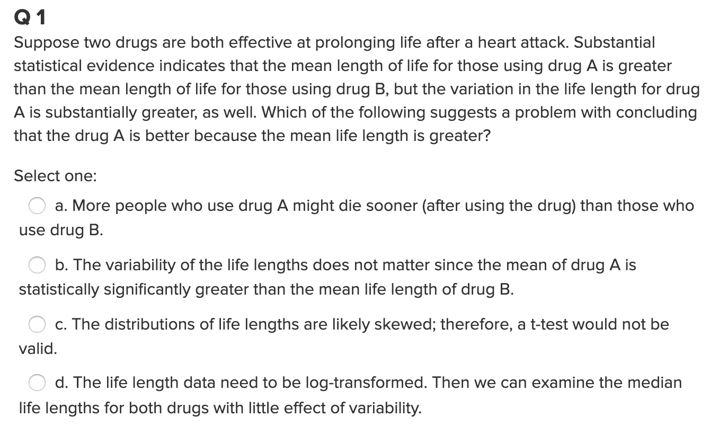
Question 1

Slide 4
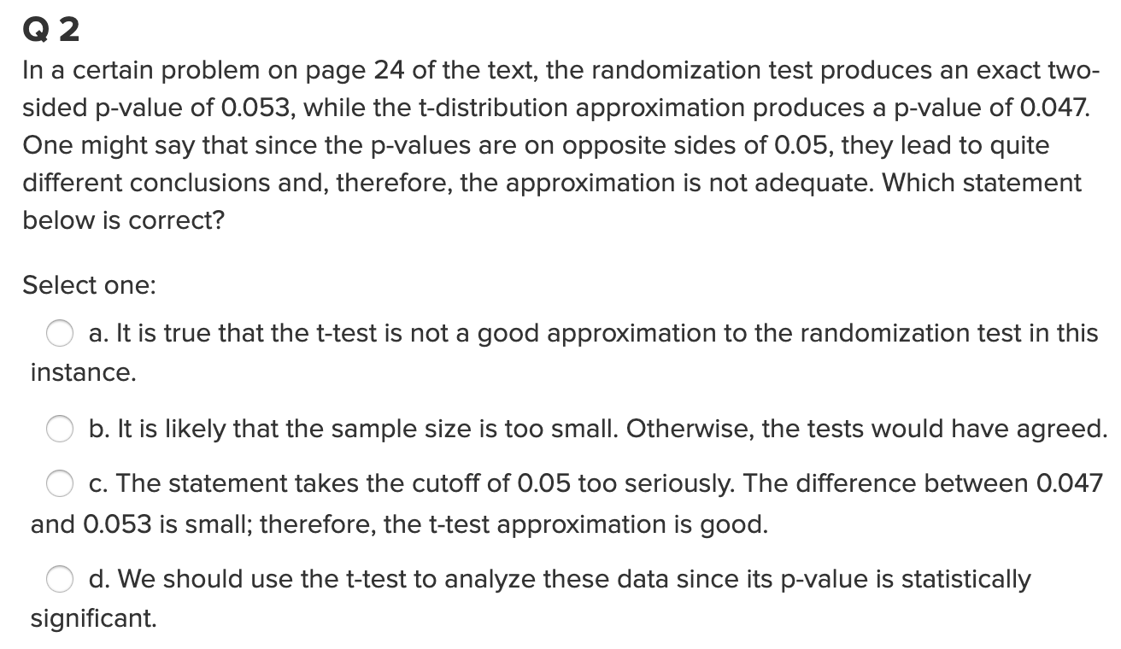
Question 2

Slide 5
End Question 1

Slide 6

Question 2 ($≤2$ hours)

Slide 7
When wildfires ravage forests, the timber industry argues that logging (actual logging of trees … not the mathematical log!) the burned trees enhances forest recovery; the EPA argues the opposite. The 2002 Biscuit Fire in southwest Oregon provided a test case. Researchers selected 16 fire-affected plots in 2004, before any logging was done and counted tree seedlings along a randomly located transect pattern in each plot. They returned in 2005, after nine of the plots had been logged, and counted the tree seedlings along the same transects. The percent of seedlings lost from 2004 to 2005 is recorded in the file logging.csv for logged (L) and unlogged (U) plots:
Test the EPA’s assertion (and thus the opposite of the logging industries assertion) that logging (again…. not the mathematical log! :) actually increases the percentage of seedlings lost from 2004 to 2005.
Perform a complete analysis using a rank sum test in SAS. (Logging data).
Verify the p-value and confidence interval by running the rank sum test in R (using R function Wilcox.test). (You do not need to repeat the complete analysis … simply cut and paste a screen shot of your code and the output.) You may use: https://www.r-bloggers.com/wilcoxon-mann-whitney-rank-sum-test-or-test-u/ for reference.
Finally, perform a permutation test for the difference of means. As with all ”tests”, this should include a clear conclusion written in the context of the problem and in terms understandable by a client (although it should also include a pvalue.)

Slide 8
End Question 2

Slide 9
Question 3: Takeaways!
Please provide at least 4 takeaways from this section and any questions that you may have. These questions will help design the live session for this unit.
This question will be the last question of every For Live Session Assignment. The idea is that this deck will serve as a document that you can reference in the future to remember what was covered in this section. For instance, this may come in handy for the Capstone and will hopefully become useful in your career. Most immediately, it may become handy as a quick reference for your Midterm and Final! Some students find it very useful and spend a few slides summarizing the asynch material while others learn different ways and only had the minimum 4 takeaways. Either is fine and will earn you full credit for this question.

Slide 10
Question 4: Questions!
Please provide any question or topics of discussion that came up in this Unit! These will help help us optimize our live session for maximum learning and takeaways!
This question will be the last question of every For Live Session Assignment. The idea is that this deck will serve as a document that you can reference in the future to remember what was covered in this section. For instance, this may come in handy for the Capstone and will hopefully become useful in your career. Most immediately, it may become handy as a quick reference for your Midterm and Final! Some students find it very useful and spend a few slides summarizing the asynch material while others learn different ways and only had the minimum 4 takeaways. Either is fine and will earn you full credit for this question.

Slide 11
End For Live Session Assignment Unit 5!

